Slide 1
Task 2 Installing Roles & Features
William Roberts
CIS216 Windows Server
Stephen Leggett
9/9/2025

Slide 2
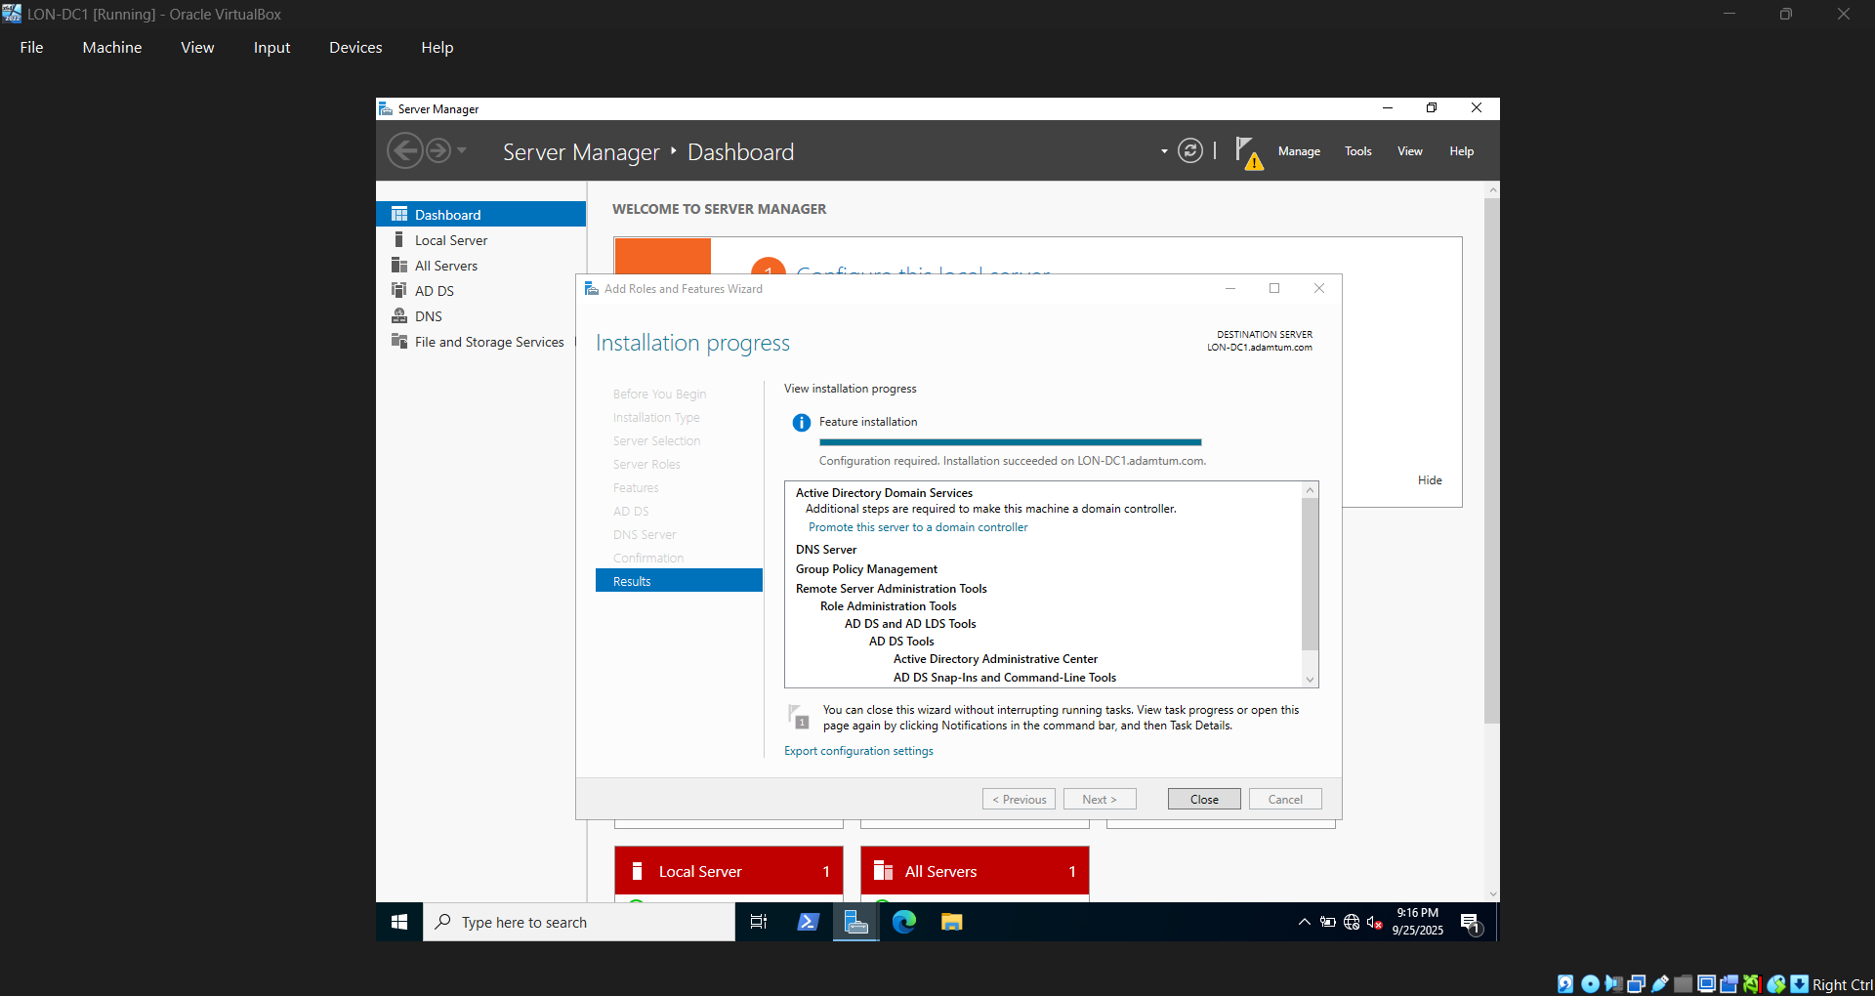
LON-DC1 has installed
Active Directory Domain Services
DNS Server

Slide 3
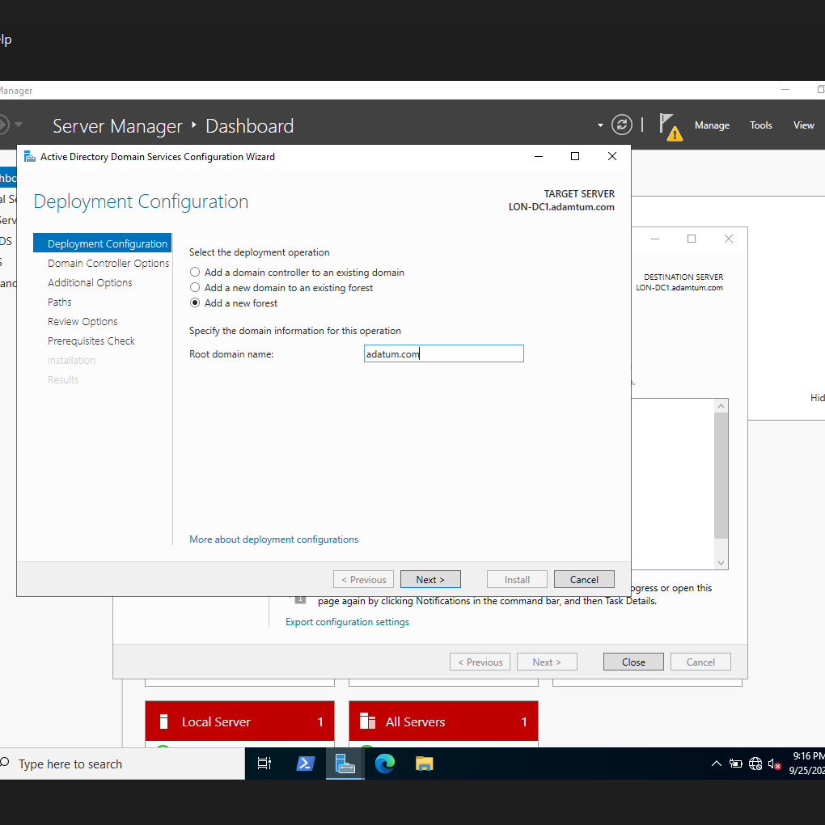
Root Domain adatum.com

Slide 4
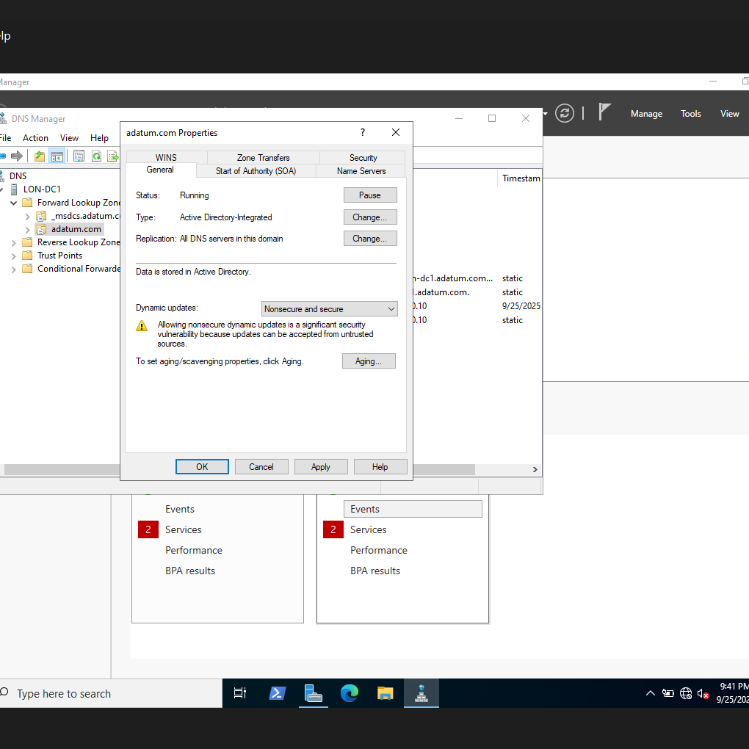
Dynamic Update

Slide 5
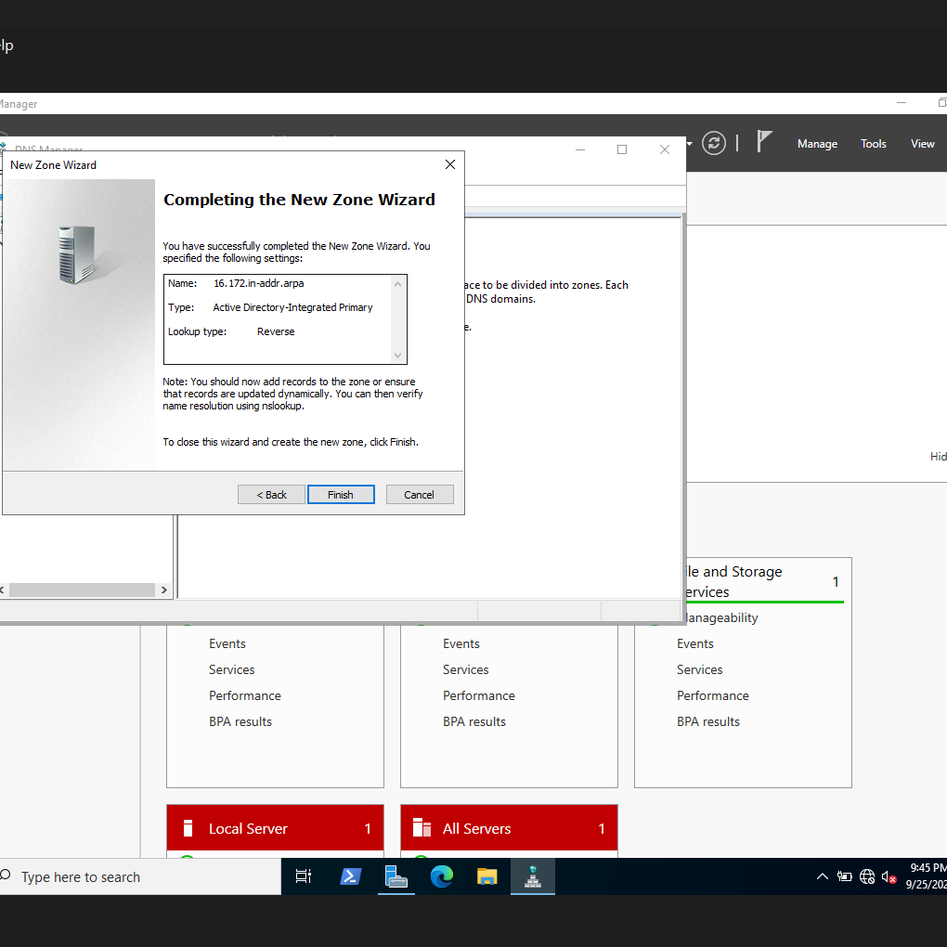
Add new Zone

Slide 6
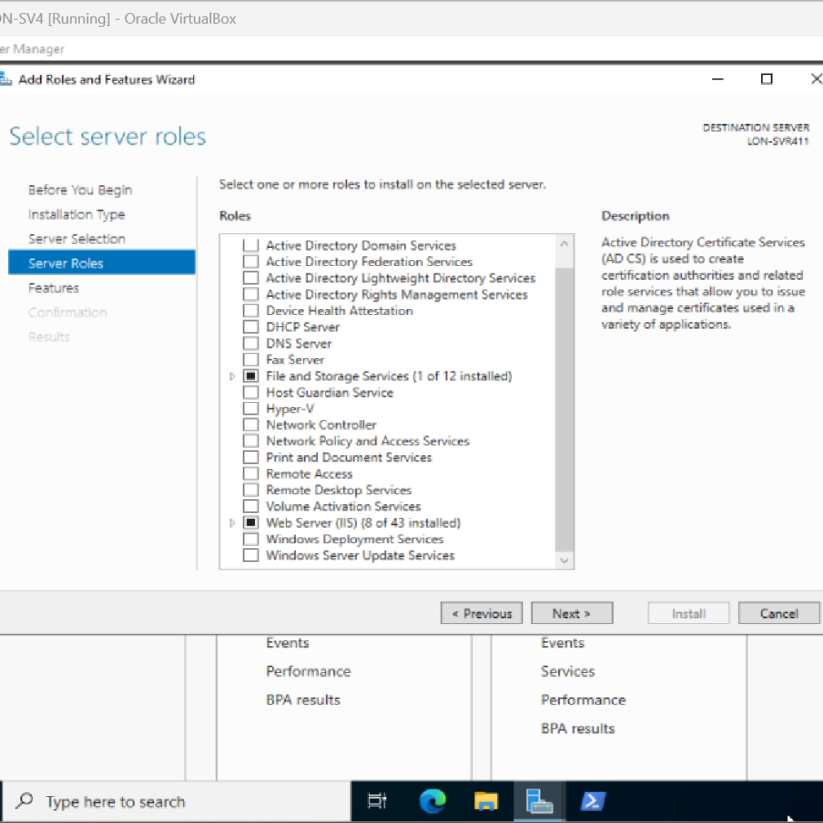
SVR4 Web Server (IIS)

Slide 7
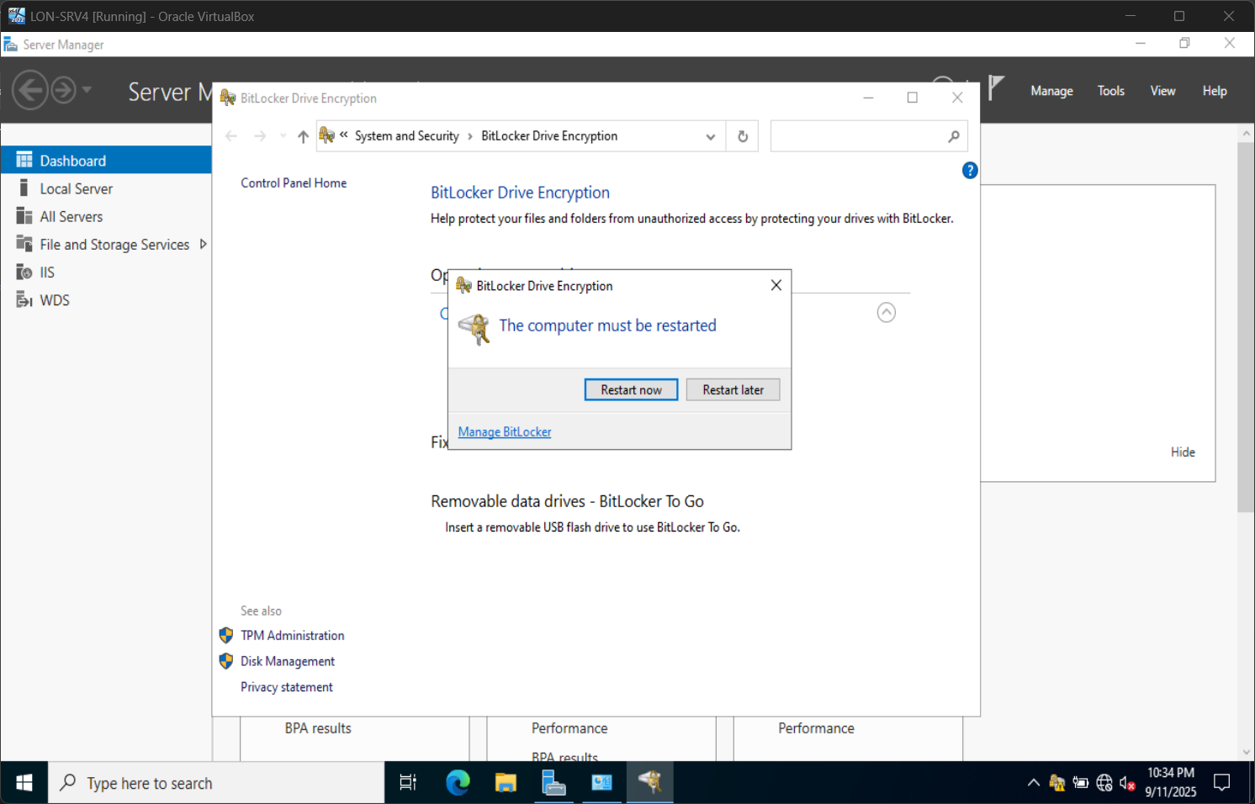
LON-SVR4 BitLocker

Slide 8
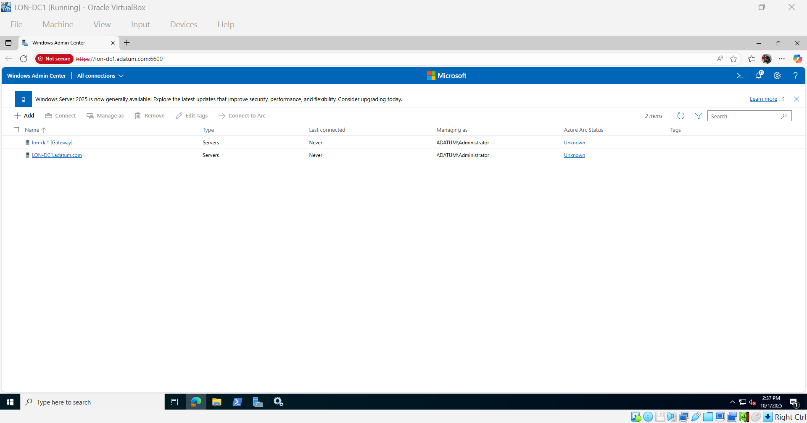
Register a new server

Slide 9
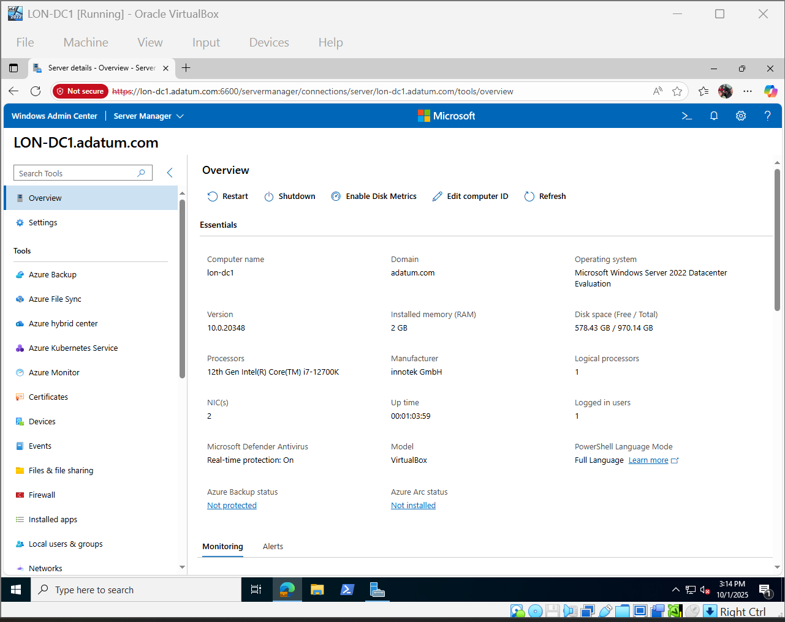
Explore Server Overview

Slide 10
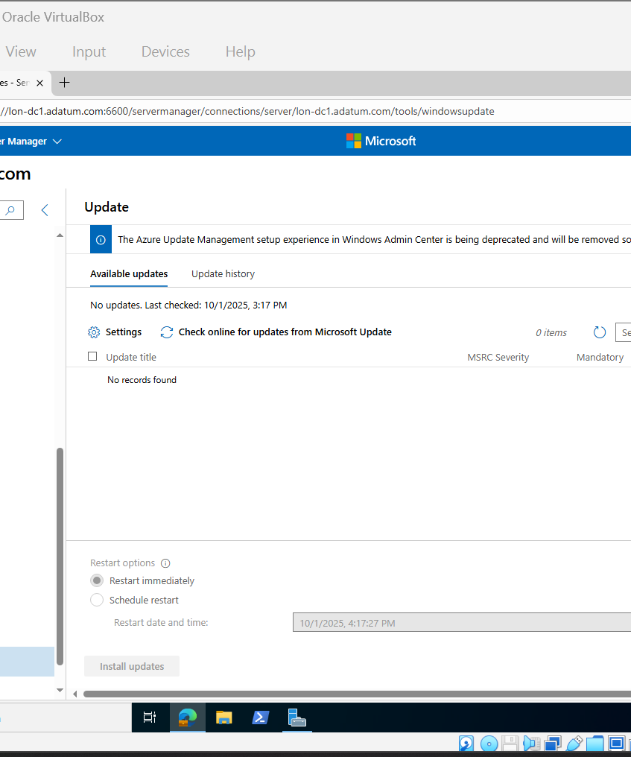
Check for and install available Windows updates

Slide 11
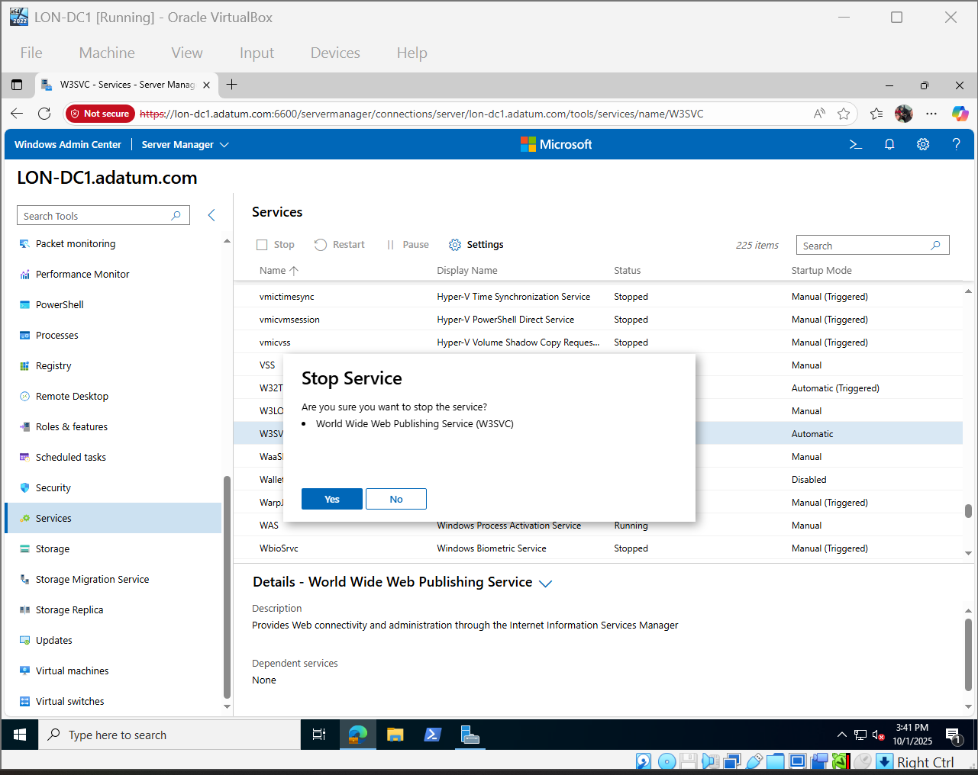
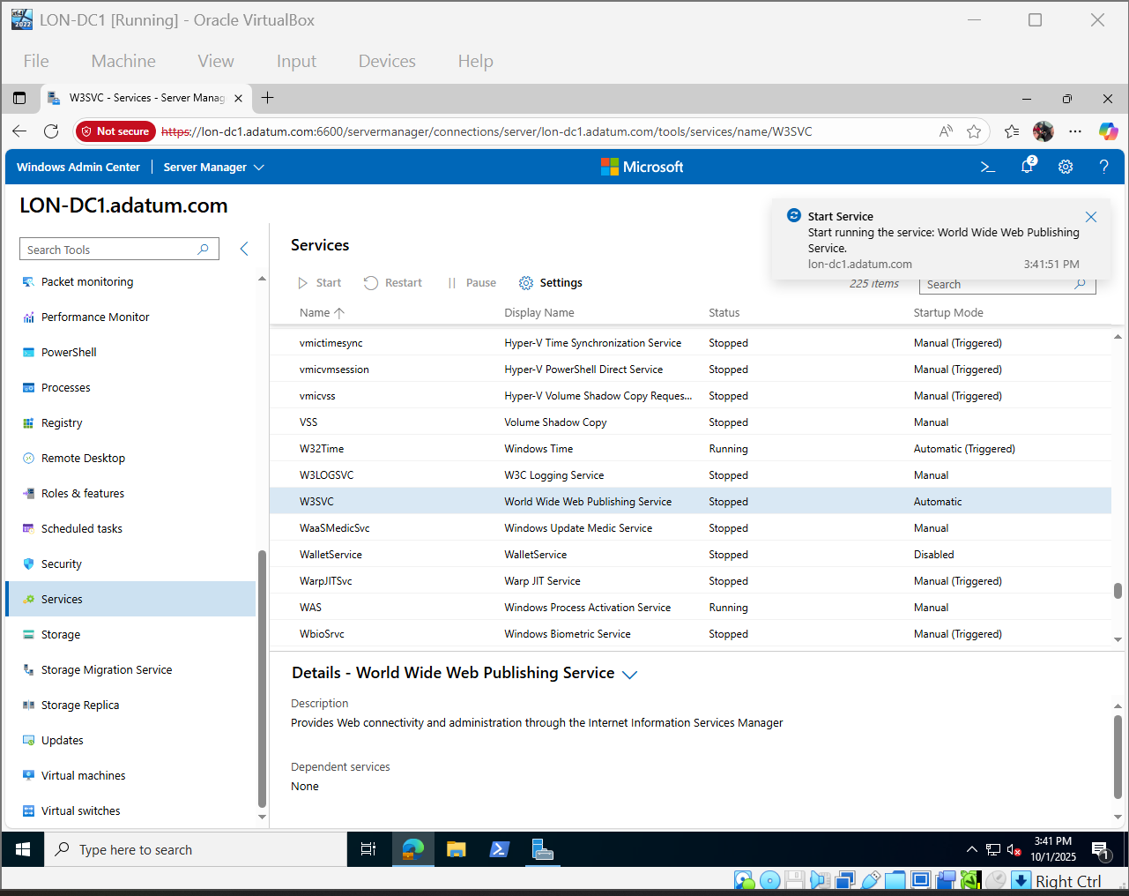
Monitor and Manage Services

